Slide 1
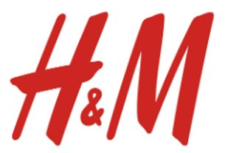
H&M Personalized Fashion Recommendation
Team Members: Sirisha Gadepalli, Chi-Chien(May) Tsai, Bekhzod Aliev, Shiyao(Will) Zhang, Garima Singhal, Mayank Tripathi, James Lee

Slide 2
AGENDA
1.
2.
Project Definition & Variables
Problem Statement
4.
3.
Methodology
Data Exploration
5.
6.
Result
Conclusion

Slide 3
Problem Statement
Part1. Problem Statement
H&M needs a fashion recommendation model to sustain the increased sales from their online channel post COVID19 pandemic.
Why:
Sales dropped by 20% from 2019-2020
Increased overhead cost for stores
Extensive range of products for online shoppers
Reducing footfall in brick-and-mortar stores
Notes:
H&M needs a fashion recommendation model to sustain the increased sales from their online channel post COVID19 pandemic.

Slide 4
Part2. Project Definition & Variables
Variables
Split Data
Article Data
25 columns
105541 unique article
Train Size 80%
Merge Data
Customers Data
7 columns
1371980 unique values
ArticleID &
CustomerID
Test Size 20%
Transaction Data
5 columns
31800000 unique transaction

Slide 5
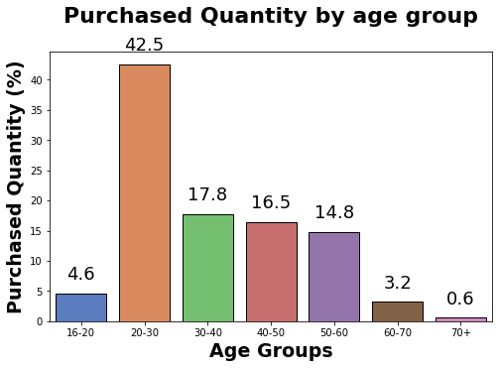
Data Exploration: Purchased Quantity by age group
Part3. DATA EXPLORATION ​
Based on this analysis, H&M will be targeting the younger generation particularly between the ages of 20 - 40 years. The age bracket represents 60% of total sales.

Slide 6
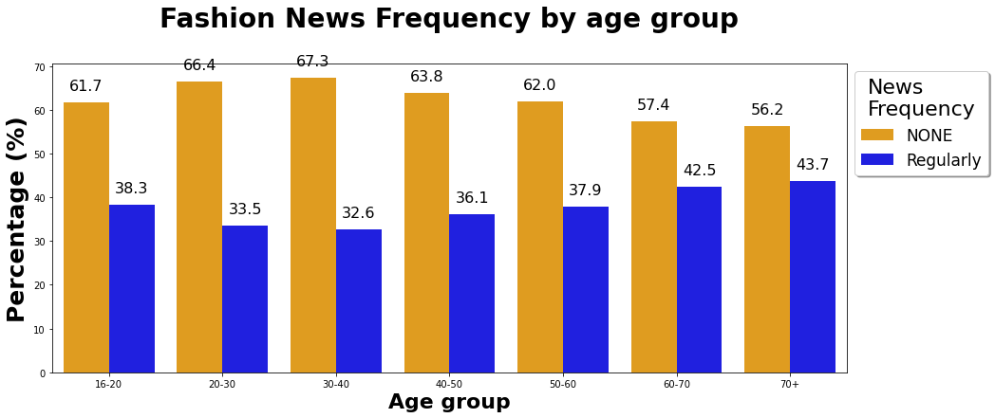
Part3. DATA EXPLORATION ​
Data Exploration: Fashion News Frequency by age group
People of age group 60 and above are more likely to make a purchase if they are active on fashion news frequency whereas only 33% sales were made via newsletter in most contributing age group (20 - 40 years)

Slide 7
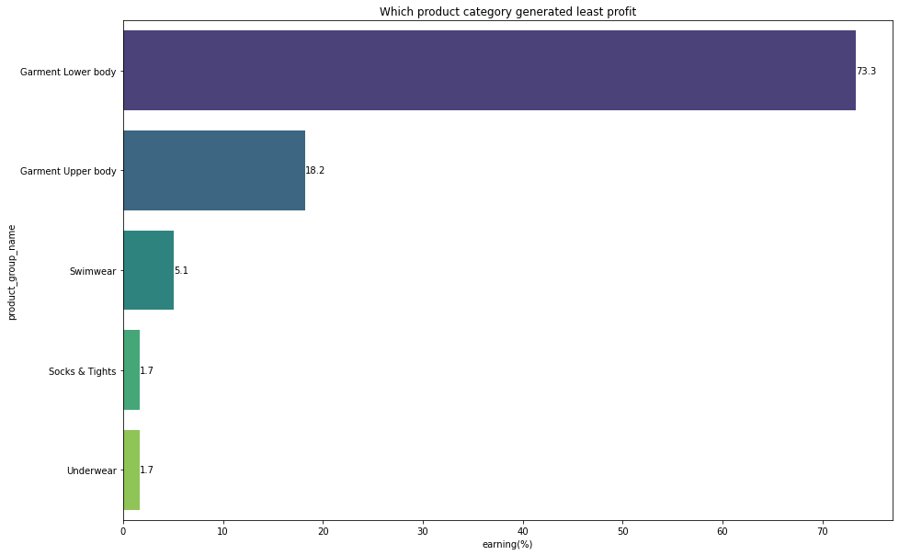
Part3. DATA EXPLORATION ​
Data Exploration: Which product category generates the least profit?
Seaborn:
sns.barplot
palette="viridis"
Garment Lower body: 73.3%
Insight:
HM should control the inventory of this category to avoid losing money.

Slide 8
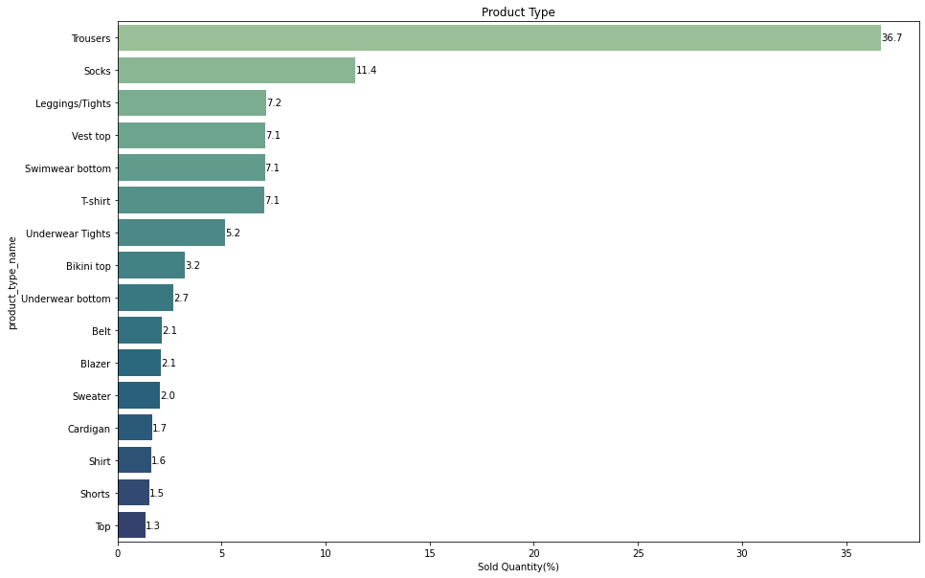
Data Exploration: The most popular product type
Part3. DATA EXPLORATION ​
Seaborn:
sns.barplot
palette="crest"
Trousers: 36.7%
Trousers, socks and leggings have been the most bought items with combined sales of 55.3%

Slide 9
Part4. Methodology
Data Preparation for Methodology
Transaction Data
- Filtered data from September 2019 to September 2020
- Group by customer id and article id for total sale count
Merged Data
(Transaction-Customer-Article)
- Filled age with mean value
- Filled fashion news and active with zero
Articles Data
Select article_id and clusters column
Customer Data
Drop postal_code

Slide 10
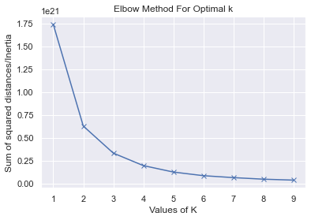
Part4. Methodology
Methodology for K-means Clustering
K-means clustering is the first step of assist H&M building their product recommendation system for customers
Elbow method suggest for optimal k=4,
Thus, we decide to cluster our data into 4 group

Slide 11
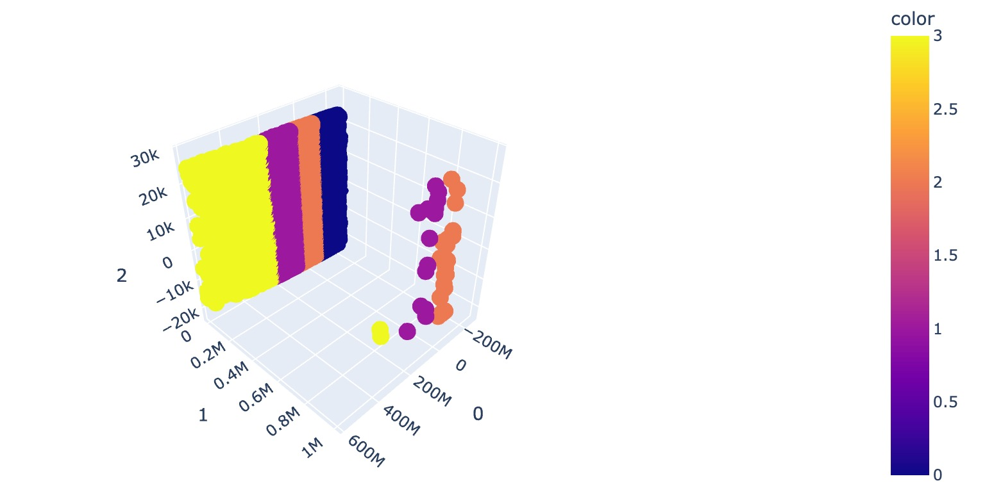
Part4. Methodology
K-means Clustering - PCA
- Large dataset with multiple dimensions, we utilize PCA to reduce dimensions
- Cluster the similar data points based on the feature correlation between them without any supervision

Slide 12
Methodology for Predictive Analytics
Part4. Methodology
1. Build a model where it predicts, through customer's attributes, what cluster of articles they would most likely be most interested in.
This aims to push personalized shopping to customers.
2. For each customer, showcase items in specific cluster on early pages.
3. Increases the chances of a customer running into items they like -> increase the probability of them making a purchase.
Data:​
Train data: ​ Customer variables , Article bought​, Cluster Group (Article_id has been used to match the articles to their respective clusters)​
Predictors:​ Age, Fashion News, Price​
Outcome:​ Cluster Group

Slide 13






Models
Part5. Results
Modeling Results
 |  | Accuracy Score
 | Decision Tree | 77.99
 | KNN | 67.36
 | Gradient Boosting Classifier | 62.65
 | Random Forest | 60.53
 | Gaussian Naive Bayes | 54.86
 | Linear Support Vector Classification | 54.19

Slide 14
Results
Part5. Results
105541
4
articles
clusters
Across all the channels including 53 online markets
Every article belongs to a particular cluster
645641
77.99%
Sample data size
Accuracy Score
Randomly selected 5% from 12.9 million rows
Decision Tree Model

Slide 15
Part6. Conclusion
Conclusion
We recommend fast fashion retailer H&M to use decision tree to provide personalized fashion recommendation
Decision Tree has highest accuracy of 77.99%
Create relevant product association which facilitates faster decision making
Enhances Shopping Experience
Increases the likelihood to make a purchase

Slide 16
References
H&M. (2022, February 7). H&M personalized fashion recommendations. Kaggle.
Retrieved May 3, 2022,
from https://www.kaggle.com/competitions/h-and-m-personalized-fashion-recommendations
Python PCA tutorial: Principal component analysis with Sklearn. DataCamp Community. (n.d.).
Retrieved May 3, 2022,
from https://www.datacamp.com/community/tutorials/principal-component-analysis-in-python
Data Science in retail industry: Data Science Use Cases in retail industry.
Analytics Vidhya. (2021, May 11). Retrieved May 3, 2022,
from https://www.analyticsvidhya.com/blog/2021/05/data-science-use-cases-in-retail-industry/
KNN classification tutorial using Sklearn Python. DataCamp Community. (n.d.).
Retrieved May 3, 2022,
from https://www.datacamp.com/community/tutorials/k-nearest-neighbor-classification-scikit-learn

Slide 17


